Slide 1

CSE- 4105
Lecturer- 04

Slide 2
Line Drawing Algorithms
Bresenham’s line drawing
Efficient line drawing algorithm using only incremental integer calculations
Can be adapted to draw circles and other curves
Principle
Vertical axes show scan line positions
Horizontal axes show pixel columns
At each step, determine the best next pixel based on the sign of an integer parameter whose value is proportional to the difference between the vertical separations of the two pixel positions from the actual line.

Slide 3
Big idea.
Move across the x axis in unit intervals and at each step choose between two different y coordinates
For example, from position (2, 3) we have to choose between (3, 3) and (3, 4)
5
(x_{p}+1, y_{p}+1)
4
(x_{p}, y_{p})
3
(x_{p}+1, y_{p})
2
2
3
4
5

Slide 4
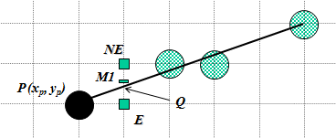
Choosing a pixel
We can move either to East (E)or North east (NE)
Choose E

Slide 5
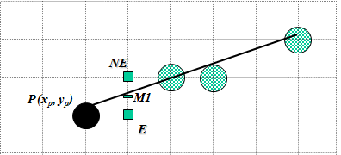
Choosing a pixel
We can move either to East (E)or North east (NE)
Choose NE

Slide 6
Choosing a pixel
We can move either to East (E)or North east (NE)
Option depends on the midpoint M1

Slide 7
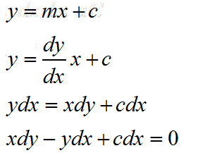
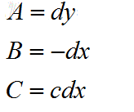

Equation

Slide 8
Big idea.
If we choose E then we have to calculate the next mid point dnew
5
5
4
4
d_{new}
d_{old}
d_{old}
3
3
2
2
2
3
4
5
2
3
4
5

Slide 9
Big idea.
If we choose NE then we have to calculate the next mid point dnew
5
5
d_{new}
4
4
d_{old}
d_{old}
3
3
2
2
2
3
4
5
2
3
4
5

Slide 10
We have to calculate the decision variable d
If d<0 , E is chosen
If d>0, NE is chosen
D=F (x_{p}+1, y_{p}+1/2)
= A(x_{p}+1)+B(y_{p}+1/2)+C
5
4
d_{old}
3
2
2
3
4
5

Slide 11




How to update d :
On the basis of picking E or NE, figure out the location of M for that pixel, and the corresponding value of d for the next grid line.
If E is chosen:
M is incremented by one step in the x direction
incremental difference ΔE=d_{new}-d_{old}
5
4
d_{new}
d_{old}
3
2
2
3
4
5

Slide 12


How to update d :
If NE is chosen:
M is incremented by one step each in both the x and y directions
incremental difference ΔNE=d_{new}-d_{old}
5
d_{new}
4
d_{old}
3
2
2
3
4
5

Slide 13
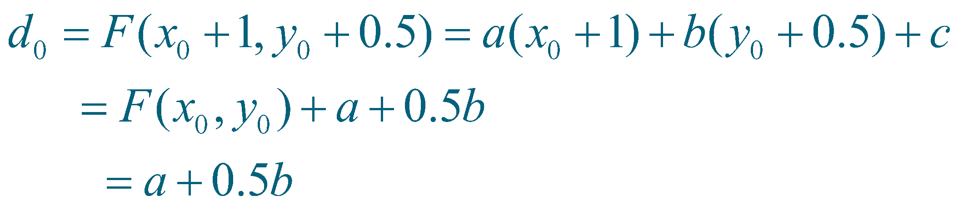
Initial value of d₀
Initial value of d

Slide 14
Algorithm
DrawLine(int x1, int y1, int x2, int y2, int color)
{
int dx, dy, d, incE, incNE, x, y;
dx = x2 - x1;
dy = y2 - y1;
d = 2*dy - dx;
incE = 2*dy;
incNE = 2*(dy - dx);
y = y1;
for (x=x1; x<=x2; x++)
{
WritePixel(x, y, color);
if (d>0) {
d = d + incNE;
y = y + 1;
} else {
d = d + incE;
}
}
}

Slide 15
Thank You

